Slide 1
Software Design & Analysis
Data Flow Diagram

Slide 2
Data Flow Model
Captures the flow of data in a system
It helps in developing an understanding of system’s functionality
What are the different sources of data, what different transformations take place on data and what are final outputs generated by these transformations
It describes data origination, transformations and consumption in a system

Slide 3
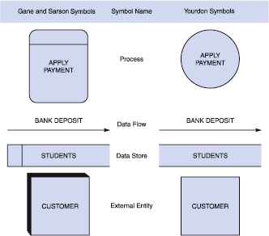
DFD Symbols

Slide 4
Process
  The work or actions performed on data so that they are transformed, stored, or distributed.
  Process labels should be verb phrases!

Slide 5
Data Flow
  A path for data to move from one part of the system to another.
  Data in motion!
    Arrows depict the movement of data.
  NO VERBS

Slide 6
Data Store
  Used in a DFD to represent data that the system stores
  Data at rest!
  Labels should be noun phrases
    (NO VERBS)

Slide 7
External Entity aka Source/Sink
  The origin or destination of data!
    This represents things outside of the system, Can be a person, a company or another system.
  Source – Entity that supplies data to the system.
  Sink – Entity that receives data from the system.
  The labels should be noun phrases!

Slide 8
General DFD Rules
YES
NO
A process to another process
A process to an external entity
A process to a data store
An external entity to another external entity
An external entity to a data store
A data store to another data store

Slide 9
Illegal Data Flows
✗
A process is needed to exchange data between external agents
Patient
Doctor
Patient
Doctor

Slide 10
Illegal Data Flows
✗
A process is needed to update a data store
Patient
Data Store
Data Store
Patient

Slide 11
Illegal Data Flows
✗
A process is needed to copy data from one data store to another
Data Store
Data Store
Data Store
Data Store

Slide 12
Detailed Data Flow diagrams

Slide 13
The Levels
Context (Level 0) - Overview - contains only one process
Level 1 - Utilises all four elements
Level 2 - A breakdown of a level 1 process
Level 3 - A breakdown of a level 2 process
There is no rule as to how many levels of DFD that can be used.

Slide 14
Rules
Sequence not important - getting the Process correct is
Context or Level 0 - Identifies the system/ boundary /External Links
Level 1 - Overview of function
Level 2 - Breakdown to Understand
  Hard to know where to stop
  Rule of Thumb
  If there are more than 8 data flows break it
  Process of Identifying major Processes

Slide 15
Level 0 - Context Diagram
models system as one process box which represents scope of the system
identifies external entities and related inputs and outputs

Slide 16
Level 1 - overview diagram
gives overview of full system
identifies major processes and data flows between them
identifies data stores that are used by the major processes
boundary of level 1 is the context diagram

Slide 17
Level 2 - detailed diagram
level 1 process is expanded into more detail
each process in level 1 is decomposed to show its constituent processes
boundary of level 2 is the level 1 process

Slide 18
Numbering
On level 1 processes are numbered 1,2,3…
On level 2 processes are numbered x.1, x.2, x.3… where x is the number of the parent level 1 process
Number is used to uniquely identify process not to represent any order of processing
Data store numbers usually D1, D2, D3...

Slide 19
Labelling
Process label - short description of what the process does, e.G. Price order
Data flow label - noun representing the data flowing through it e.G. Customer payment
Data store label - describes the type of data stored
Make labels as meaningful as possible

Slide 20


Patient Monitoring System
Patient
Patient Monitoring System
Nurse
Patient Log

Slide 21

Patient Monitoring System – Level 1 DFD
Patient
Patient bounds
Local
Monitoring
Vital signs
Bounds
Warning Message
Central Monitoring
Nurse
Report Generator
Patient Log

Slide 22
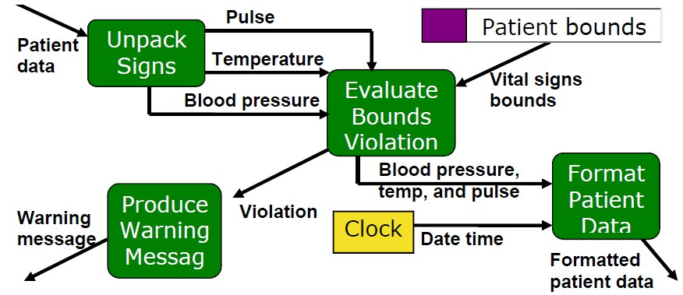
Patient Monitoring System – Level 2 DFD

Slide 23
Identifying operations
The SafeHome security function enables the homeowner to configure the security system when it is installed, monitors all sensors connected to the security system, and interacts with the homeowner through the Internet, a PC, or a control panel.
During installation, the SafeHome PC is used to program and configure the system. Each sensor is assigned a number and type, a master password is programmed for arming and disarming the system, and telephone number(s) are input for dialing when a sensor event occurs.
When a sensor event is recognized, the software invokes an audible alarm attached to the system. After a delay time that is specified by the homeowner during system configuration activities, the software dials a telephone number of a monitoring service, provides information about the location, reporting the nature of the event that has been detected. The telephone number will be redialed every 20 seconds until a telephone connection is obtained.
The homeowner receives security information via a control panel, the PC, or a browser, collectively called an interface. The interface displays prompting messages and system status information on the control panel, the PC, or the browser window.

Slide 24
Context Diagram
Find the people who send data into the system
  Often data is part of a PHYSICAL transaction
  When handing a bar of chocolate to a shopkeeper, you are handing him/her a barcode.
Find the people who get data out of the system.
  The only data you need is data that is transformed or sent completely out of the system – not data that is handled by an operator within the system.

Slide 25
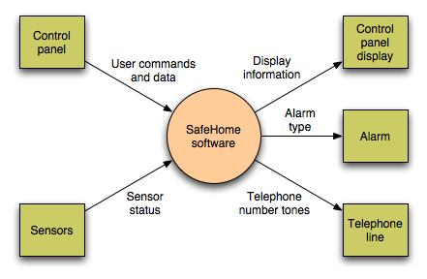
Data Flow Diagram
Context-level DFD for SafeHome security function

Slide 26
Identifying operations
The SafeHome security function enables the homeowner to configure the security system when it is installed, monitors all sensors connected to the security system, and interacts with the homeowner through the Internet, a PC, or a control panel.
During installation, the SafeHome PC is used to program and configure the system. Each sensor is assigned a number and type, a master password is programmed for arming and disarming the system, and telephone number(s) are input for dialing when a sensor event occurs.
When a sensor event is recognized, the software invokes an audible alarm attached to the system. After a delay time that is specified by the homeowner during system configuration activities, the software dials a telephone number of a monitoring service, provides information about the location, reporting the nature of the event that has been detected. The telephone number will be redialed every 20 seconds until a telephone connection is obtained.
The homeowner receives security information via a control panel, the PC, or a browser, collectively called an interface. The interface displays prompting messages and system status information on the control panel, the PC, or the browser window. Homeowner interaction takes the following form…

Slide 27
Verbs from the description
The SafeHome security function enables the homeowner to configure the security system when it is installed, monitors all sensors connected to the security system, and interacts with the homeowner through the Internet, a PC, or a control panel.
During installation, the SafeHome PC is used to program and configure the system. Each sensor is assigned a number and type, a master password is programmed for arming and disarming the system, and telephone number(s) are input for dialing when a sensor event occurs.
When a sensor event is recognized, the software invokes an audible alarm attached to the system. After a delay time that is specified by the homeowner during system configuration activities, the software dials a telephone number of a monitoring service, provides information about the location, reporting the nature of the event that has been detected. The telephone number will be redialed every 20 seconds until a telephone connection is obtained.
The homeowner receives security information via a control panel, the PC, or a browser, collectively called an interface. The interface displays prompting messages and system status information on the control panel, the PC, or the browser window. Homeowner interaction takes the following form…

Slide 28
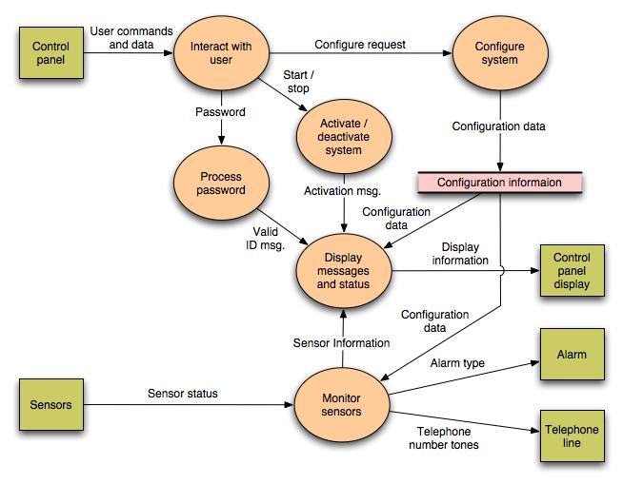

Slide 29
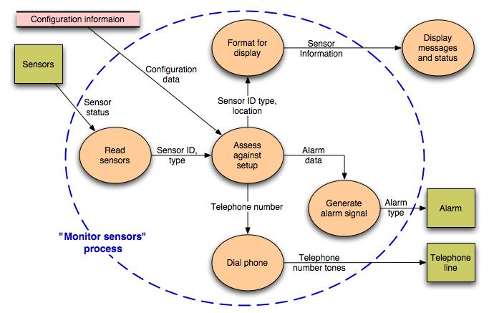
Level 2 DFD that refines the monitor sensors process

Slide 30
DFD – Example (Home Task)
Place Requests for CDs
  Customers will access the Internet system to look for CDs of interest. Some customers will search for special CDs or CDs by specific artists, while other customers want to browse for interesting CDs in certain categories (e.g. rock, jazz, classical).
  When the customer has found a CD he or she wants, the customer will check to see which store(s) have the CD in stock. They will use zip code to find stores close to their location.
  Customers can immediately place a hold on any CD in stock at any of the stores and then come into the store and pick it up (see requirement 3 below).
  If the CD is not available in the customer’s preferred store, the customer can request that the CD be special ordered to that store for later pickup. The customer will be notified by e-mail when the requested CD arrives at requested store; the CD will be placed on hold (which will expire after 7 days). This process will work similarly to the current special order system.

Slide 31
DFD – Example (Home Task)
CD Marketing
  The Internet system provides an additional opportunity to market CDs to current and new customers. The system will provide a database of marketing materials about selected CDs that will help Web users learn more about them (e.g., music reviews, links to Web sites, artist information, and sample sound clips). When information about a CD that has additional marketing information is displayed, a link will be provided to the additional information.
  Marketing materials will be supplied primarily by vendors and record labels so that we can better promote their CDs. The Marketing Department will determine what marketing materials will be placed in the system and will be responsible for adding, changing and deleting the materials.
Process In-store Holds
  When a CD is available in a store, the system will send a hold request to the in- store system at the selected store.
  The in-store system will alter the store staff (through an audible alarm and a pop- up message).
  Staff will print a label for the requested CD(s), pull them from the shelves, attach the label, and place them on the special order shelf. Just like the special orders, the hold items will be held for 7 days.
  Once the hold has been placed on the shelf, the staff will enter a hold confirmation, and the system will do an inventory adjustment to the main inventory database so that no other holds are accepted for the item.

